Slide 1
Sprint 3 Liquor Store Profits Prediction
Lucia Zou
Lucia.zouyuebca@gmail.com
Nov.24th, 2023

Slide 2

To predict future profits for liquor stores
Can we use machine learning models to predict
future profits of liquor?

Slide 3

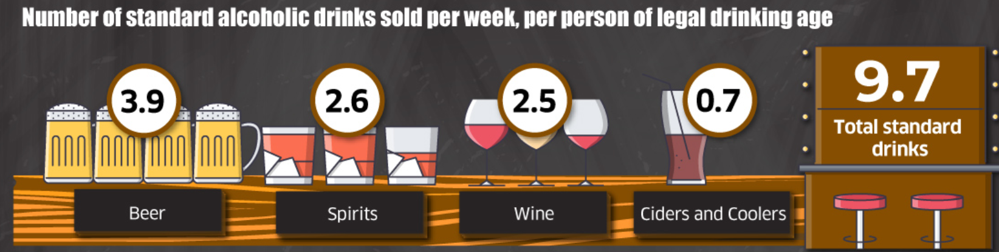
Why?
Big Market
Curiosity
Data Source: Alcohol Sales in Canada, April 2020 to March 2021 (statcan.gc.ca)

Slide 4
Solve the Problem
Step 1
Step 2
Step 3
Step 4
Collect Data
Data Cleaning
EDA
Feature Engineering
Step 5
Step 6
Step 7
Basic Models
Advanced Models
Conclusion

Slide 5

01
Collect Data

Slide 6


Introduction
--- Iowa class E liquor holders' data --- From Jan 2021 to Jan 2022 --- 2805307 Rows and 24 Columns --- Data Source: https://www.kaggle.com/datasets/gabrielramos87/iowa-sales-liquor-jan-2021jan-2022

Slide 7

02
Data Cleaning

Slide 8


Data Cleaning

Slide 9
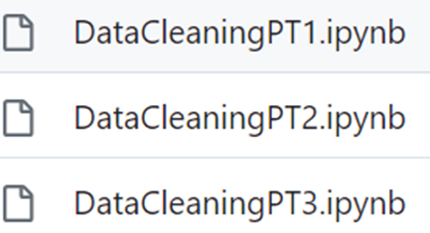
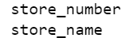
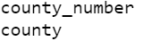
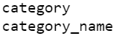
What I did for Cleaning
PT1
PT2
PT3
Fill in null values for store locations
Matching the
unique values
Matching the
unique values again

Slide 10

03
EDA

Slide 11
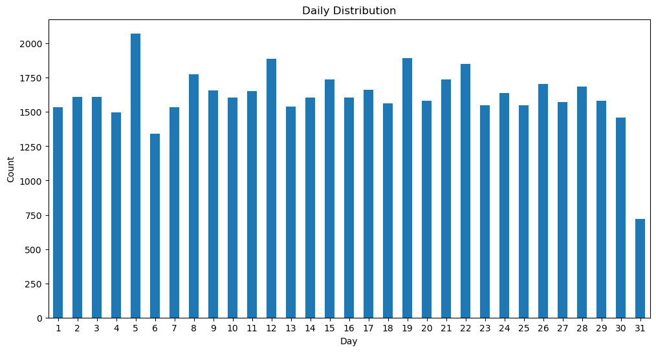
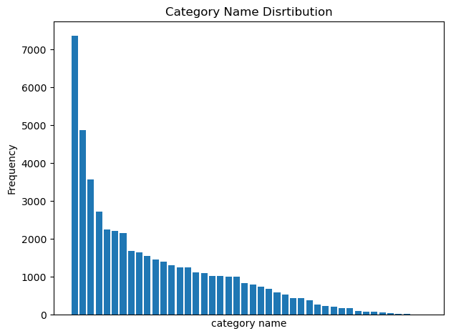
Findings
Notes:
Around the middle of the month, there is a slight increase followed by a decrease in the count, which might correspond to mid-month paydays or special promotions/events.

Slide 12

04
Feature Engineering

Slide 13
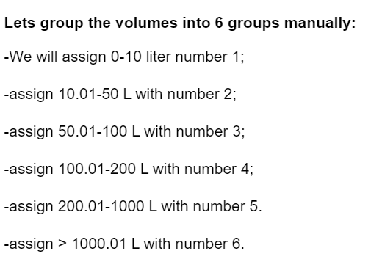
Feature Engineering
Profit
Combine 3 columns for calculation
Simplify alcohol categories
Alcohol Type
Dummie variables

Slide 14
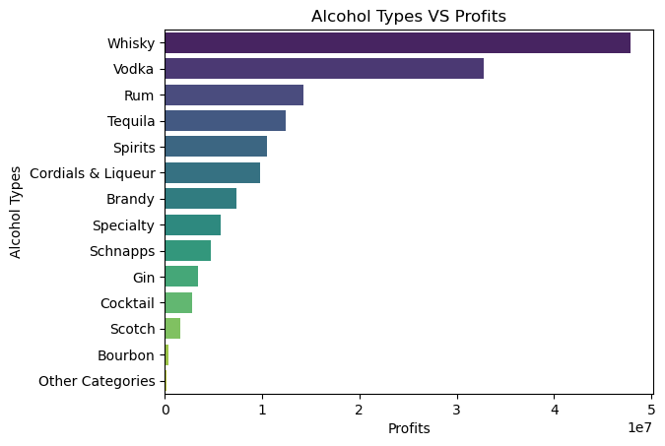
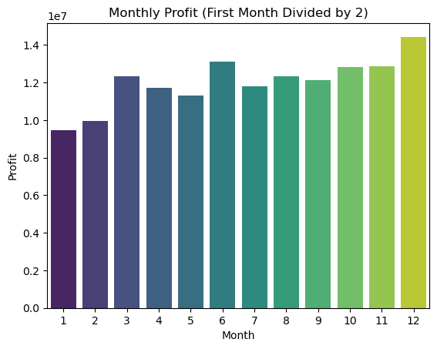
Key Findings

Slide 15
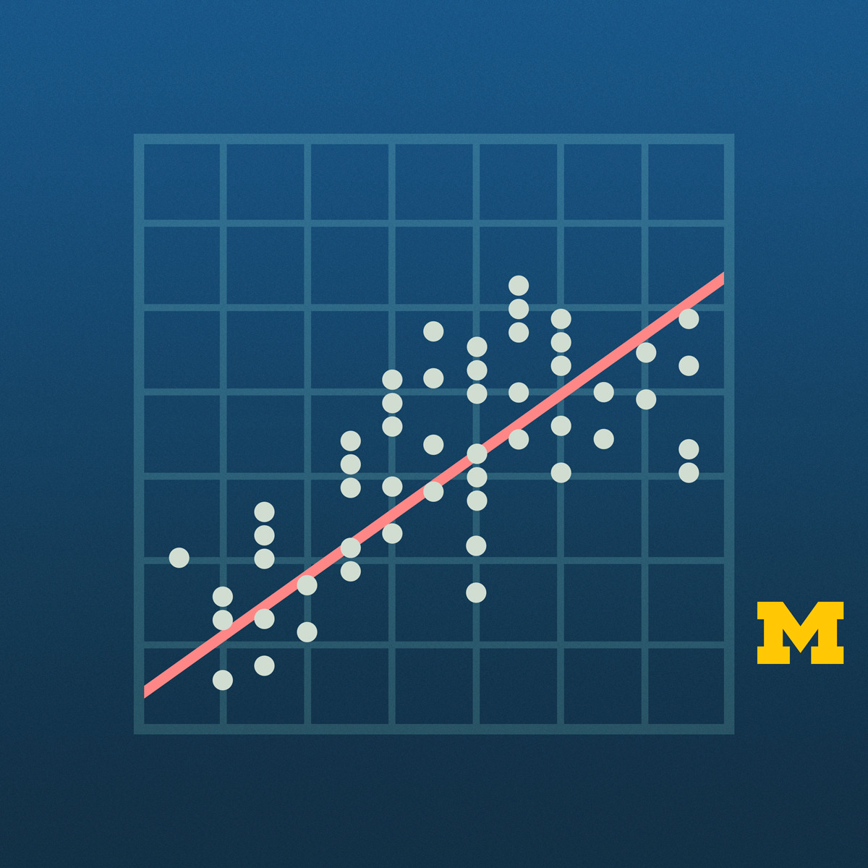
05
Basic Models

Slide 16

Choosing Models
Who is the best?
Linear | Simplicity
Lasso | Regularization
Ridge | Regularization, prevent overfitting
Decision Tree | Easy to understand
Random Forest | Reduce Overfitting
XG Boost | Includes Lasso and Ridge
drum roll please...

Slide 17
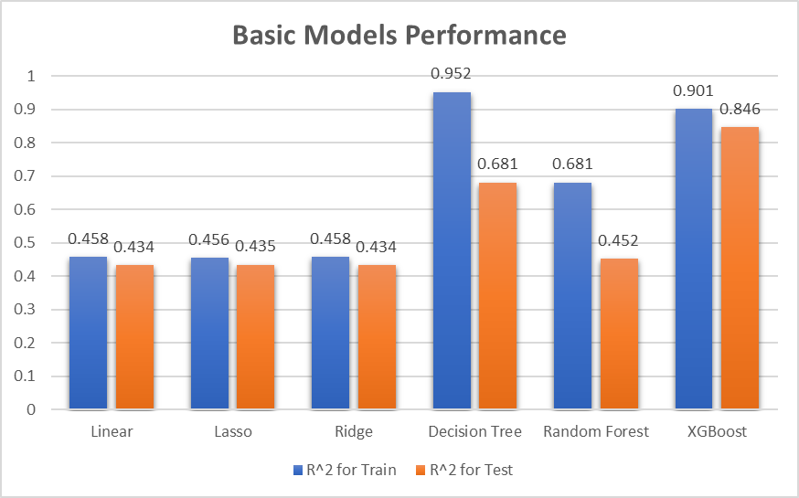
Notes:
Linear, Lasso, and Ridge Models
These three models exhibit very similar performance on both training and test datasets, there is very little overfitting here, and the train and test scores are quite close.
The Linear, Lasso, and Ridge models show very little overfitting, as the training and test R² values are close. However, their overall performance is lower than the more complex models.
Decision Tree
shows a significant difference between the training and test R² values. The training R² is very high at around 0.952, while the test R² drops down to approximately 0.681. This suggests that the Decision Tree model is overfitting.
Random Forest Model
shows high performance on the training data. Its performance on the test data does not drop dramatically, indicates that the model is generalizing better than the single Decision Tree.
XGBoost
has the best performance on the test data among all models, with an R² of approximately 0.846, and its training score is around 0.901. The XGBoost model shows a higher ability to generalize with less overfitting compared to the Decision Tree and Random Forest models.

Slide 18
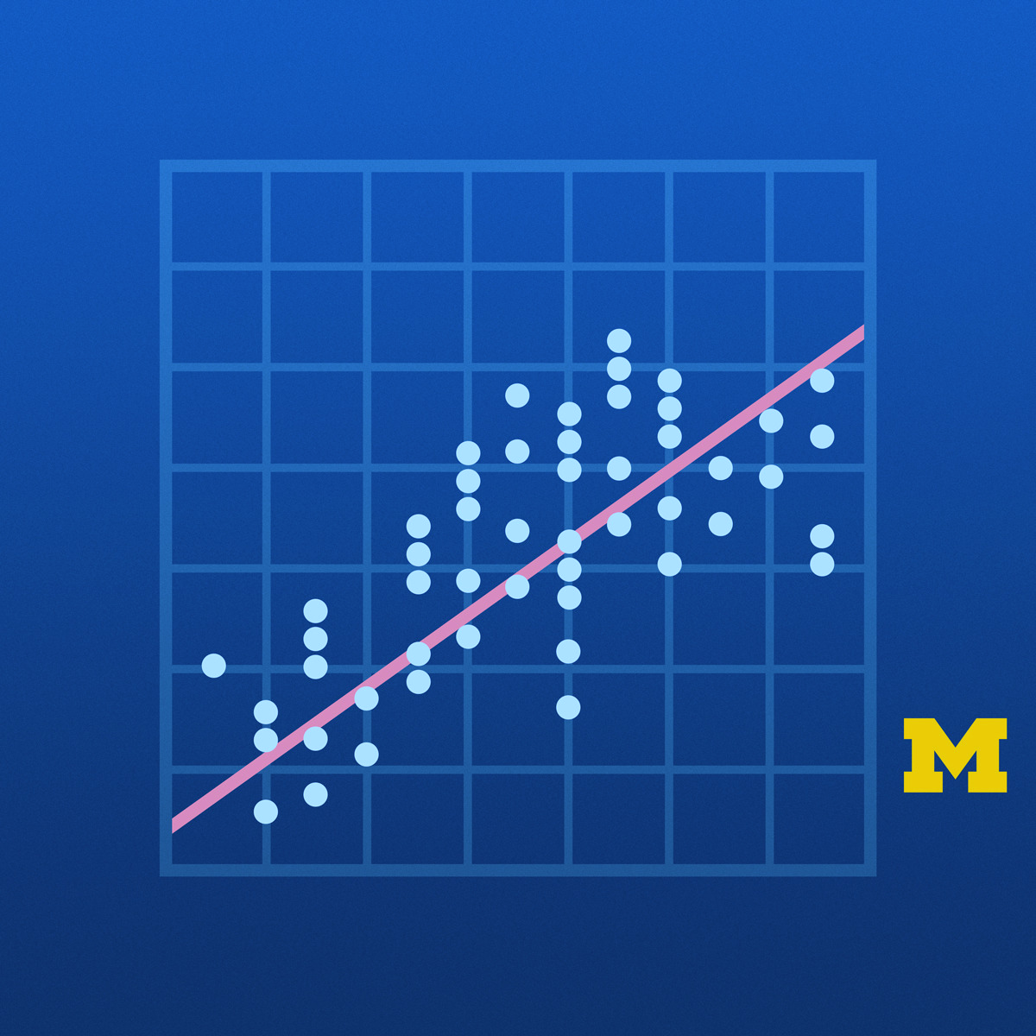
06
Advanced Models

Slide 19
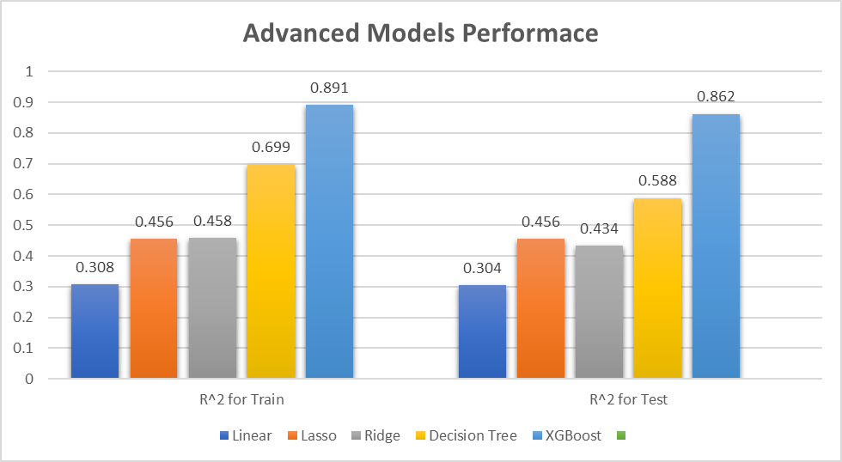

Notes:
Linear Regression
has the lowest R² on both training and test datasets, indicating that it has the worst performance among all models.
Ridge
Performs slightly better than Lasso on the trained data but has a lower R² on the test data. This suggests that Ridge may be overfitting slightly compared to Lasso.
Decision Tree Model
Exhibits a significant drop in R² from training to test data, indicating overfitting
Random Forest Model
(Shows a high R² on the training data, similar to the Decision Tree model. However, it generalizes better to the test data with an R² of about 0.588, which is a considerable improvement over the Decision Tree model.)
XGBoost Model
Has the highest R² on both training (around 0.862) and test. This suggests that the XGBoost model has the best generalization ability among the models presented and a strong fit on the training data without overfitting as much as the Decision Tree.
XGBoost outperforms the other models in terms of both fit to the training data and generalization to the test data.

Slide 20

07
Conclusion

Slide 21

To predict future profits for liquor stores
Can we use machine learning models to predict
future profits of liquor?
Yes, We can!

Slide 22


Potential Impact
2. Marketing and Sales:
Plan effective marketing campaigns and promotions to boost sales during peak periods or slow seasons.
focus advertising efforts on popular alcohol types
1. Set pricing strategies:
Adjust pricing based on
predicted demand and
seasonality to promote
revenue.

Slide 23
More…
Competitive Advantage
Respond more quickly and effectively to market changes
Strategic Decision Making
new product lines be better informed
Inventory Management
optimize inventory levels, ensuring that high-demand alcohol types are in stock
Financial Planning
more informed decisions on investments, expansions & resource allocation
Notes:
Beauty the graph:
Label the graphs with numbers
Bold the titles
Make bars close to each otherCompetitive

Slide 24
Furthermore Steps
Find a Model better than XGBoost
Market Basket Analysis
Recommendation Systems

Slide 25


THANKS!
Do you have any questions?
Lucia.zouyuebca@gmail.com
236-867-8758
https://github.com/LuciaZou?tab=projects
www.linkedin.com/in/luciazouyue

